Slide 1
UNIT9,10 and 11 Code and Concept Review

Slide 2
A Medical Test
Bob thinks he might have a rare disease. He decides to take a test for this disease and the test comes back positive. Bob decides to read a little more about the test and discovers:
For those that have the disease, 90% will test positive (indicating the presence of the disease).
For those that do not have the disease, 80% will test negative (indicating the absence of the disease).
Should Bob be worried?

Slide 3


A Medical Test
Bob thinks he might have a rare disease. He decides to take a test for this disease and the test comes back positive. Bob decides to read a little more about the test and discovers:
For those that have the disease, 90% will test positive (indicating the presence of the disease).
For those that do not have the disease, 80% will test negative (indicating the absence of the disease).
Should Bob be worried?
$$P \left(+ | D\right)= .9$$
$$P \left(− | ND\right)= .8$$

Slide 4
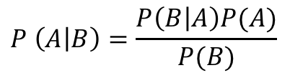
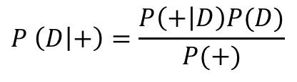
A Medical Test
Bob thinks he might have a rare disease. He decides to take a test for this disease and the test comes back positive. Bob decides to read a little more about the test and discovers:
For those that have the disease, 90% will test positive (indicating the presence of the disease).
For those that do not have the disease, 80% will test negative (indicating the absence of the disease).
Should Bob be worried?
What he really wants to know is the probability that he has the disease given that the tested positive. P( D | + )
$$P \left(A | B\right)=\frac{P\left(B | A\right)P(A)}{P(B)}$$
$$P \left(D | +\right)=\frac{P\left(+ | D\right)P(D)}{P(+)}$$
We need more information!

Slide 5


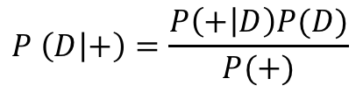
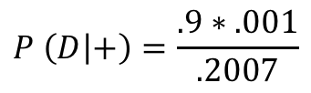

A Medical Test
Bob thinks he might have a rare disease. He decides to take a test for this disease and the test comes back positive. Bob decides to read a little more about the test and discovers:
For those that have the disease, 90% will test positive (indicating the presence of the disease).
For those that do not have the disease, 80% will test negative (indicating the absence of the disease).
Should Bob be worried?
What he really wants to know is the probability that he has the disease given that the tested positive. P( D | + )
$$P \left(D | +\right)=\frac{P\left(+ | D\right)P(D)}{P(+)}$$
$$P\left(+ | D\right)=.9$$
$$P\left(D\right)=.001$$
$$P\left(+\right)=P\left(+ | D\right)∗P\left(D\right)+P\left(+ | ND\right)∗P\left(ND\right)=.9∗.001+.2∗.999= .2007$$
$$P \left(D | +\right)=\frac{.9∗.001}{.2007}$$
$=\frac{.009}{.2007}$ = .045

Slide 6
Example: Volleyball
Outlook | Wind | Volleyball
Sunny | Low | Yes
Sunny | Hi | No
Sunny | Hi | Yes
Cloudy | Low | Yes
Cloudy | Low | No
Cloudy | Low | Yes
Cloudy | Hi | Yes
Rain | Hi | No
Rain | Hi | No
Rain | Low | Yes
What is the probability that if it is Cloudy and the Wind is High that Sammy will play volleyball?

Slide 7
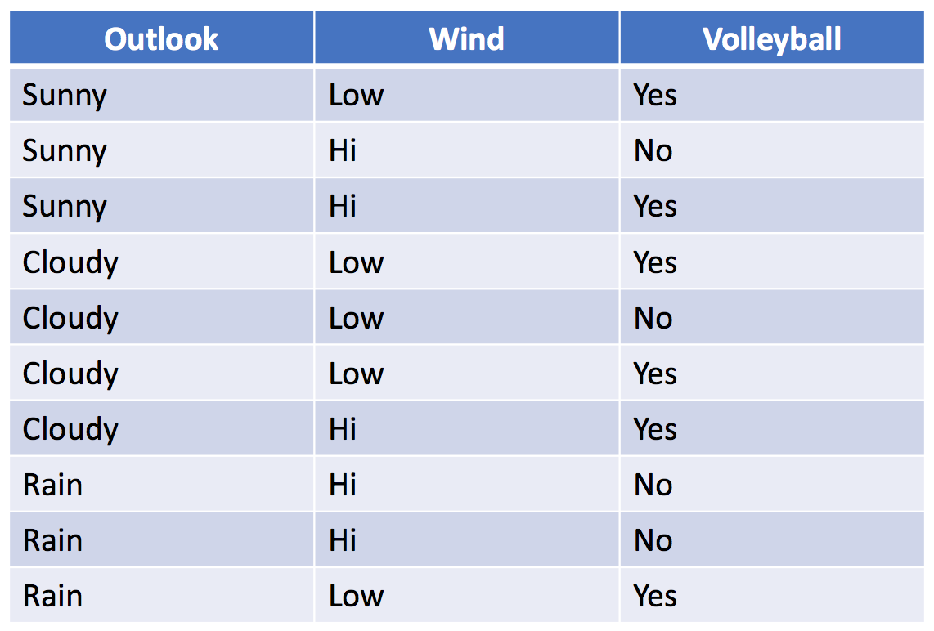
Example: Volleyball
The Naïve in Naïve Bayes means that we are
assuming that the explanatory variables are
Independent.
What is the probability that if it is Sunny and the Wind is High that he will play volleyball?
If we just look at the table, we might say 0% since we only observed one day that was Sunny and High wind and Sammy did not played on that day.
But we have 9 more observations and of the 2 Sunny days Sammy played on half of them and on the 5 highly windy days Sammy actually played on 40% of them.
Maybe this time it will be different! We are basing our estimate on only one observation. Let’s use all the information!

Slide 8
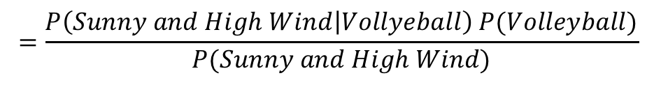

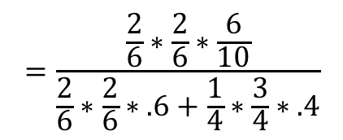
Example: Volleyball
The Naïve in Naïve Bayes means that we are
assuming that the explanatory variables are
Independent:
P(Outlook and Wind | Vball) = P(Outlook | Vball ) * P(Wind | vball)
What is the probability that if it is Cloudy and the Wind is High that we will play volleyball?
$$P \left(Volleyball | Outlook=Sunny and Wind=High\right)$$
$$=\frac{P\left(Sunny and High Wind | Vollyeball\right) P(Volleyball)}{P(Sunny and High Wind)}$$
$$=\frac{P\left(Sunny | Vollyeball\right)P\left(High Wind | Vollyeball\right)P(Volleyball)}{P\left(Sunny|Vball\right)P(HighWind|Vball)P\left(Vball\right)+P\left(Sunny|No Vball\right)P(HighWind|No Vball)P\left(No Vball\right)}$$
$$=\frac{\frac{2}{6}∗\frac{2}{6}∗\frac{6}{10}}{\frac{2}{6}∗\frac{2}{6}∗.6+\frac{1}{4}∗\frac{3}{4}∗.4}$$
$$=.4706$$

Slide 9
Example: Volleyball with naiveBayes()
# Unit 9 Naive Bayes Classifier
vball = read.csv(file.choose(),header = TRUE)
vball
install.packages("e1071") #naiveBayes()
library(e1071)
model = naiveBayes(Volleyball~.,data = vball)
predict(model,vball[,c(1,2)])
df = data.frame(Outlook = "Rain", Wind = "Hi")
predict(model,df) #just classifications
predict(model,df, type = "raw") #gives probabilities

Slide 10
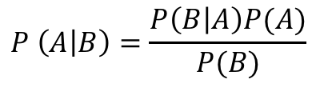
$$P \left(A | B\right)=\frac{P\left(B | A\right)P(A)}{P(B)}$$
Article | Label | Snippet
1 | N | The crime was in Central Park
2 | O | What do you think about crime?
3 | N | the crime in Central Park is
4 | N | the jogger was last seen
5 | O | One mans thoughts on the central
The crime was in Central Park
$P\left(N | W\right)= \frac{\left(1\right)(.6)}{(.8)}+\frac{\left(.66\right)(.6)}{(.6)}+\frac{\left(.66\right)(.6)}{(.4)}\text{+}$ $\frac{\left(.66\right)(.6)}{(.4)}$ + $\frac{()()}{()} + \frac{() ()}{()}\text{+}$
$P\left(O | W\right)= \frac{\left(.5\right)(.4)}{(.8)}+\frac{\left(.5\right)(.4)}{(.6)}+\frac{\left(0\right)(.4)}{(.4)}\text{+}$ $\frac{\left(0\right)(.4)}{(.4)}$ + $\frac{()()}{()} + \frac{() ()}{()}\text{+}$

Slide 11

$$P \left(A | B\right)=\frac{P\left(B | A\right)P(A)}{P(B)}$$
Article | Label | Snippet
1 | N | The crime was in Central Park
2 | O | What do you think about crime?
3 | N | the crime in Central Park is
4 | N | the jogger was last seen
5 | O | One mans thoughts on the central
The crime was in Central Park
$P\left(N | W\right)= \frac{\left(1\right)(.6)}{(.8)}+\frac{\left(.66\right)(.6)}{(.6)}+\frac{\left(.66\right)(.6)}{(.4)}\text{+}$ $\frac{\left(.66\right)(.6)}{(.4)}$ + $\frac{\left(.66\right)(.6)}{(.6)} + \frac{\left(.66\right)(.4)}{(.4)}$
$P\left(O | W\right)= \frac{\left(.5\right)(.4)}{(.8)}+\frac{\left(.5\right)(.4)}{(.6)}+\frac{\left(0\right)(.4)}{(.4)}\text{+}$ $\frac{\left(0\right)(.4)}{(.4)}$ + $\frac{\left(.5\right)(.4)}{(.6)} + \frac{\left(0\right).4)}{(.4)}$
$Article 1: P\left(N | W\right)$ > $P\left(O | W\right)$

